Slide 1
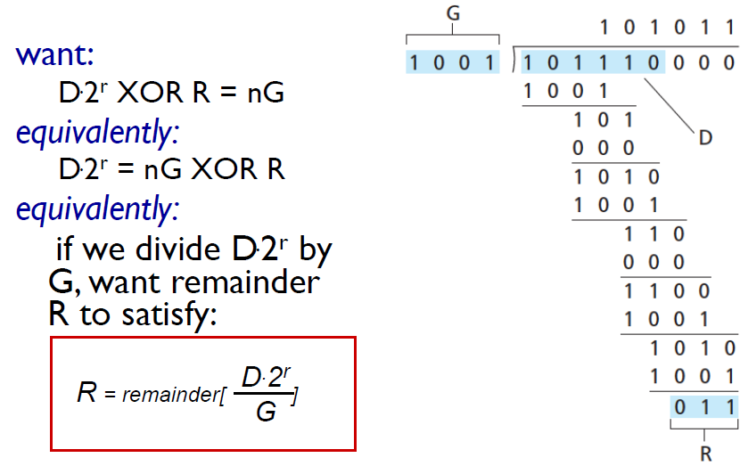
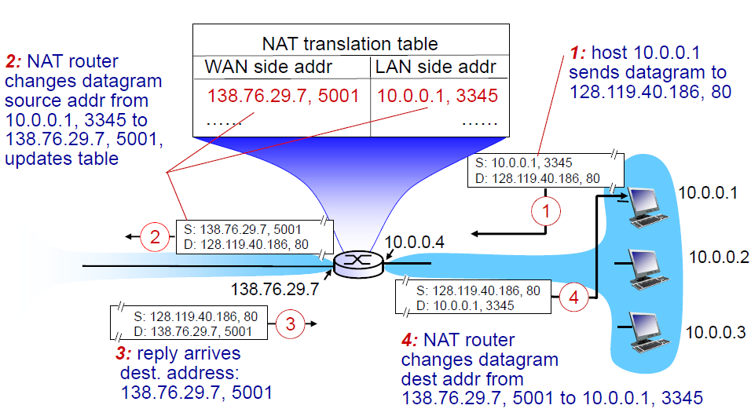
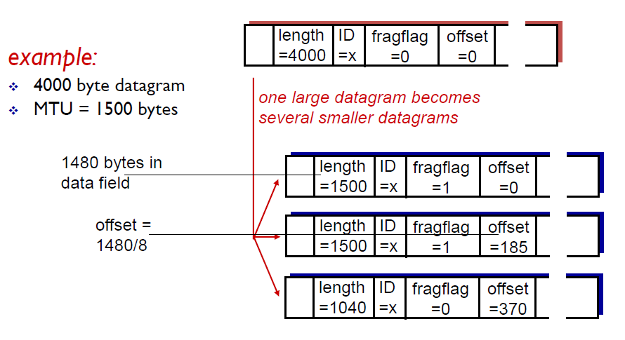
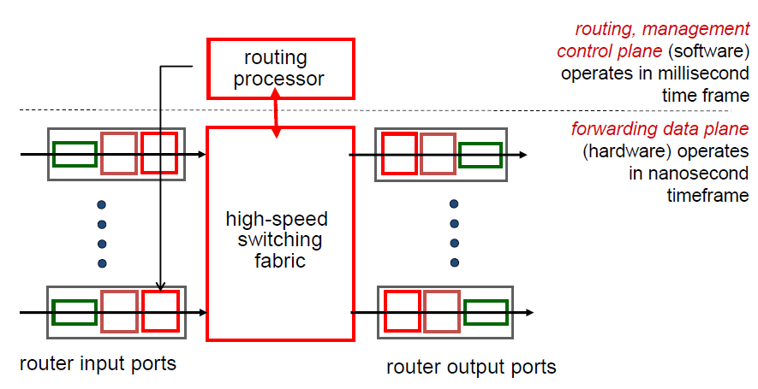
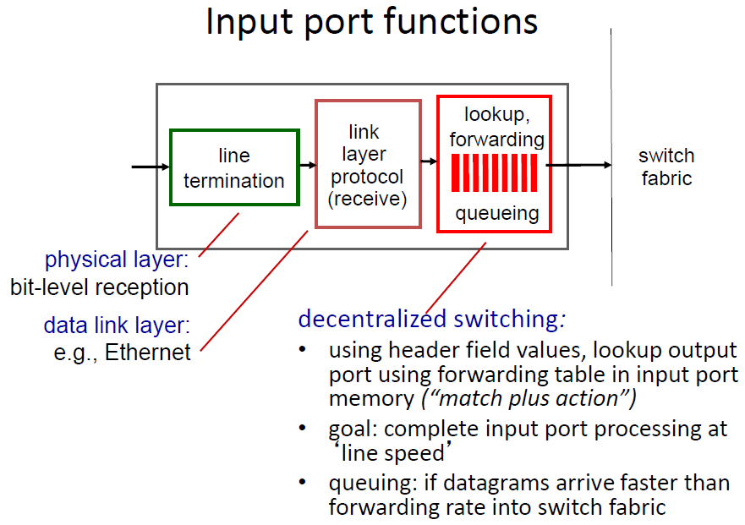
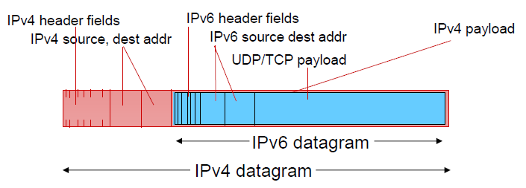
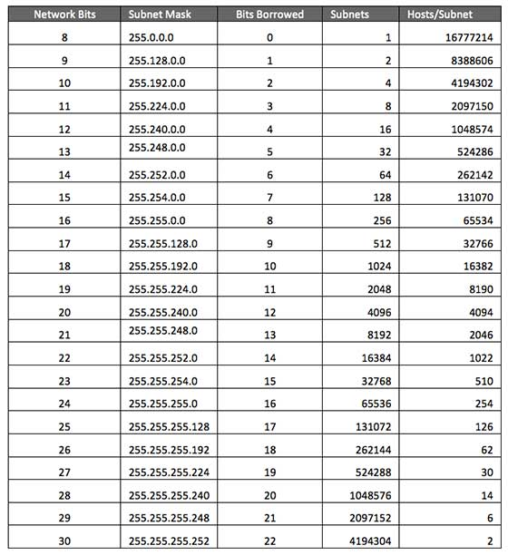
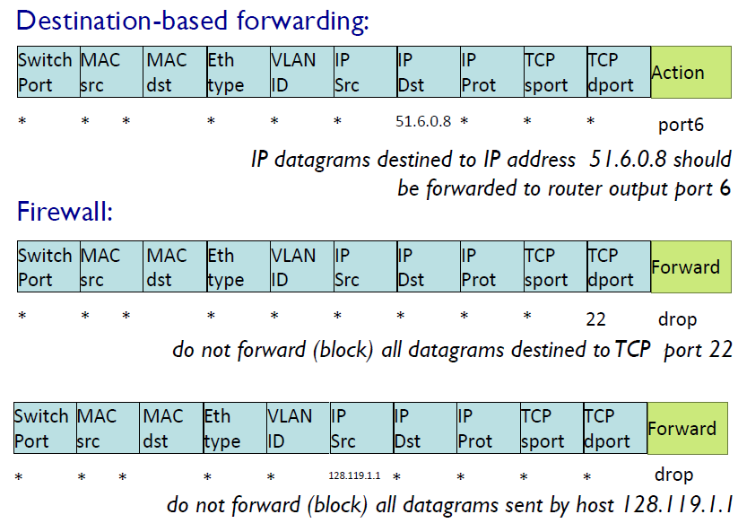
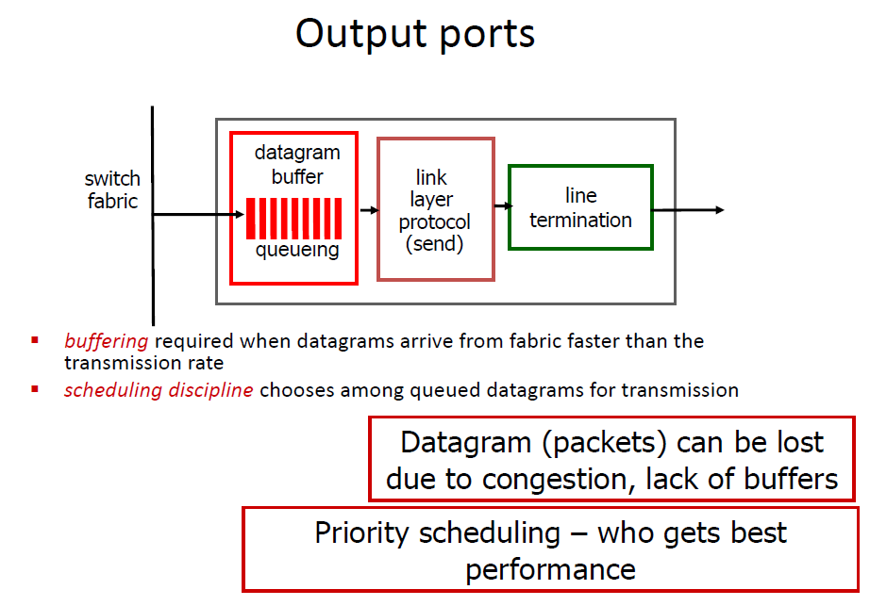
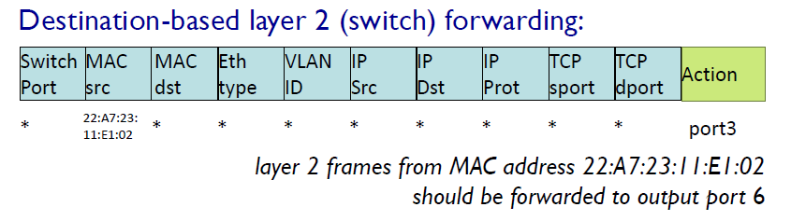
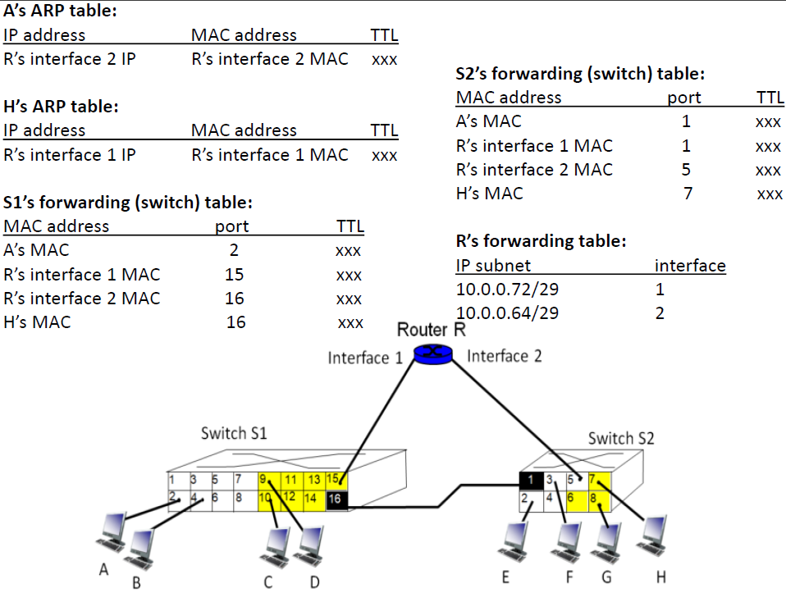
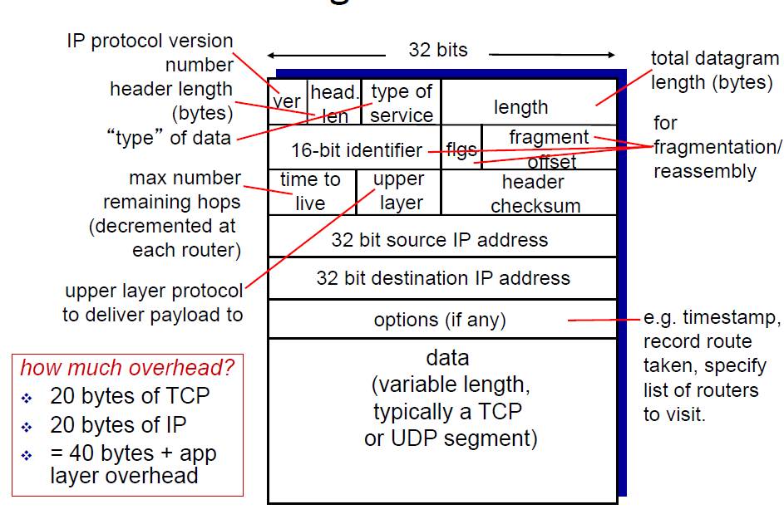
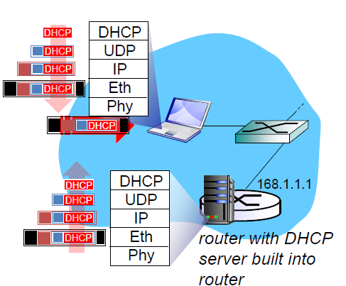
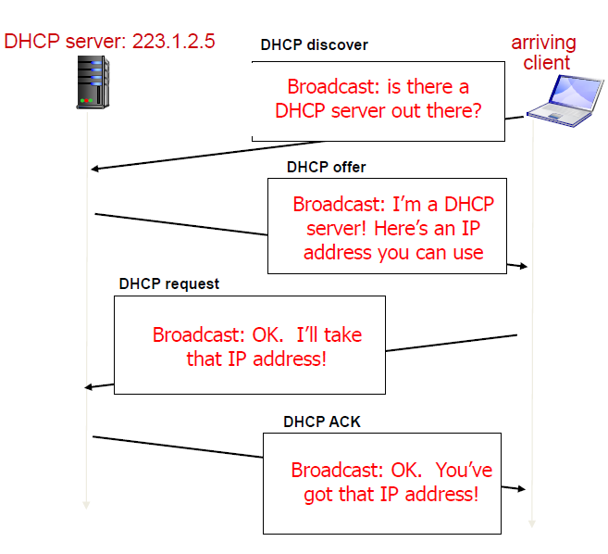
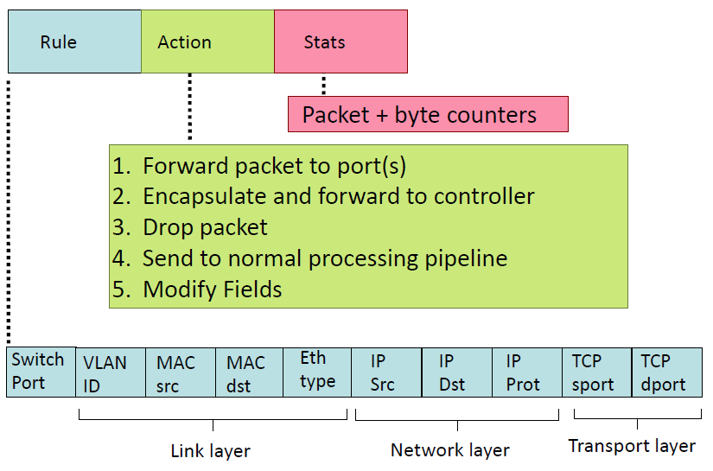
network-layer functions: (Network layer-data plane – control plane)
•forwarding: move packets from router’s input to appropriate router output
•routing: determine route taken by packets from source to destination
–routing algorithms
transport segment from sending to receiving host
on sending side encapsulates segments into datagrams
on receiving side, delivers segments to transport layer
network layer protocols in every host, router
router examines header fields in all IP datagrams passing through it
Data plane
•local, per-router function
•determines how datagram arriving on router input port is forwarded to router output port
•forwarding function
Control plane
- network-wide logic
- determines how datagram is routed among routers along end-end path from source host to destination host
- two control-plane approaches:
- traditional routing algorithms: implemented in routers
- software-defined networking (SDN): implemented in (remote) servers
•destination-based forwarding: forward based only on destination IP address (traditional)
•generalized forwarding: forward based on any set of header field values
FIFO (first in first out) scheduling: send in order of arrival to queue
–discard policy: if packet arrives to full queue: who to discard?
•tail drop: drop arriving packet
•priority: drop/remove on priority basis
•random: drop/remove randomly
priority scheduling: send highest priority queued packet
•multiple classes, with different priorities
–class may depend on marking or other header info, e.g. IP source/dest, port numbers, etc.
Round Robin (RR) scheduling:
•multiple classes
•cyclically scan class queues, sending one complete packet from each class (if available)
Weighted Fair Queuing (WFQ):
•generalized Round Robin
•each class gets weighted amount of service in each cycle
all datagrams leaving local
network have same single source NAT IP address: 138.76.29.7,different source port numbers
motivation: local network uses just one IP address as far as outside world is concerned:
▪range of addresses not needed from ISP: just one IP address for all devices
▪can change addresses of devices in local network without notifying outside world
▪can change ISP without changing addresses of devices in local network
▪devices inside local net not explicitly addressable, visible by outside world (a security plus)
implementation: NAT router must:
▪outgoing datagrams: replace (source IP address, port #) of every outgoing datagram to (NAT IP address, new port #)
. . . remote clients/servers will respond using (NAT IP address, new port #) as destination addr
▪remember (in NAT translation table) every (source IP address, port #) to (NAT IP address, new port #) translation pair
▪incoming datagrams: replace (NAT IP address, new port #) in dest fields of every incoming datagram with corresponding (source IP address, port #) stored in NAT table
1 byte = 8 bit
1kB = 1000 byte
1kb = 1000 bit
k = 10^3
M = 10^6
G = 10^9
m = 10^-3
u = 10^-6
n = 10^-9
network links have MTU (max.transfer size) - largest possible link-level frame
–different link types, different MTUs
•large IP datagram divided (“fragmented”) within net
–one datagram becomes several datagrams
–“reassembled” only at final destination
–IP header bits used to identify, order related fragments
VLAN:switch(es) supporting VLAN capabilities can be configured to define multiple virtual LANS over single physical LAN infrastructure.
port-based VLAN: switch ports grouped (by switch management software) so that single physical switch operates as multiple virtual switches
trunk port: carries frames between VLANS defined over multiple physical switches
–frames forwarded within VLAN between switches can’t be vanilla 802.1 frames (must carry VLAN ID info)
–802.1q protocol adds/removed additional header fields for frames forwarded between trunk ports
Which services are needed to operate a network like SUTD’s?
•Layer 2 connectivity --- switches, APs
•Routing (intra & inter) --- Routers
•DHCP, local DNS server
•NAT, proxies
•Security: firewall, DMZ, IDS, IPS
•User DB and authentication
•Network-attached Storage (NAS)
•journey down protocol stack complete!
–application, transport, network, link
•putting-it-all-together: synthesis!
–goal: identify, review, understand protocols (at all layers) involved in seemingly simple scenario: requesting www page
–scenario: student attaches laptop to campus network, requests/receives www.google.com
•IP address:
–subnet part - high order bits
–host part - low order bits
•what’s a subnet ?
–device interfaces with same subnet part of IP address
–can physically reach each other without intervening router
CIDR: Classless InterDomain Routing
2 IP reserve for special, broadcast and gateway
- Smallest and largest, largest is for broadcast
Transition from IPv4 to IPv6
•not all routers can be upgraded simultaneously
–no “flag days”
–how will network operate with mixed IPv4 and IPv6 routers?
•tunneling: IPv6 datagram carried as payload in IPv4 datagram among IPv4 routers
DHCP: Dynamic Host Configuration Protocol: dynamically get address from a server
goal: allow host to dynamically obtain its IP address from network server when it joins network
–can renew its lease on address in use
–allows reuse of addresses (only hold address while connected / “on”)
–support for mobile users who want to join network
DHCP overview:
–host broadcasts “DHCP discover” msg [optional]
–DHCP server responds with “DHCP offer” msg [optional]
–host requests IP address: “DHCP request” msg
–DHCP server sends address: “DHCP ack” msg
DHCP can return more than just allocated IP address on subnet:
•address of first-hop router for client
•name and IP address of DNS sever
•network mask (indicating network versus host portion of address)
Q: how does an ISP get block of addresses?
A: ICANN: Internet Corporation for Assigned
Names and Numbers http://www.icann.org/
•allocates addresses
•manages DNS
•assigns domain names, resolves disputes
▪connecting laptop needs its IP address, addr of first-hop router, addr of DNS server: use DHCP
▪DHCP request encapsulated in UDP, encapsulated in IP, encapsulated in 802.1 Ethernet
▪Ethernet frame broadcast (dest: FFFFFFFFFFFF) on LAN, received at router running DHCP server
▪Ethernet demuxed to IP demuxed, UDP demuxed to DHCP
▪DHCP server formulates DHCP ACK containing client’s IP address, IP address of first-hop router for client, name & IP address of DNS server
▪encapsulation of DHCP server, frame forwarded to client, demuxing up to DHCP at client
▪client now knows its IP address, name and IP address of DSN server, IP address of its first-hop router
Header size = 20 bytes fixed part
Transmitted from big endian
header
Big endian high byte transferred first

Slide 2
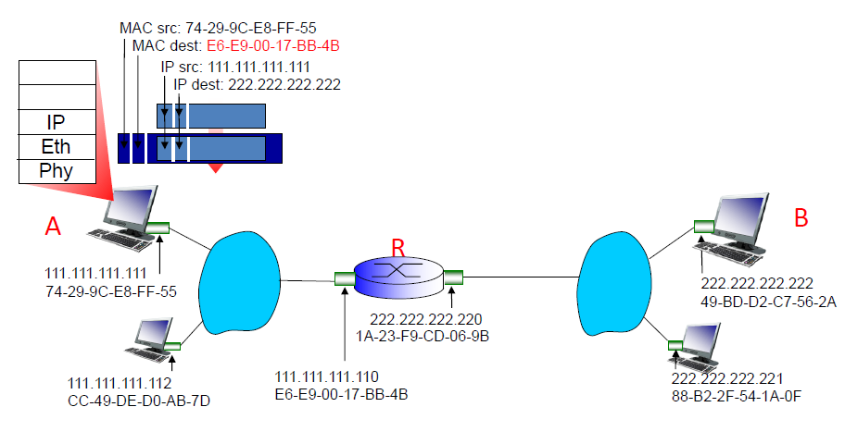
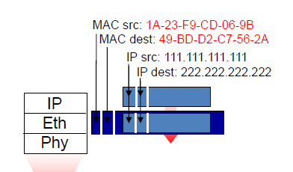
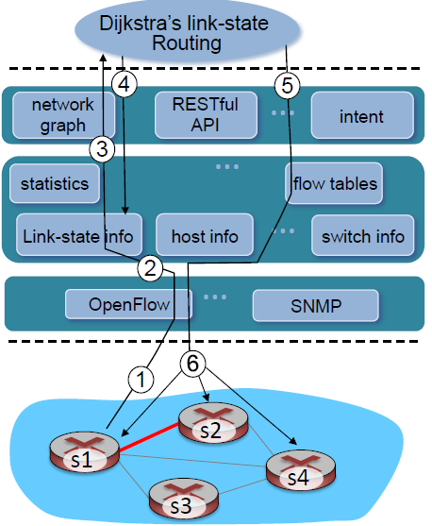
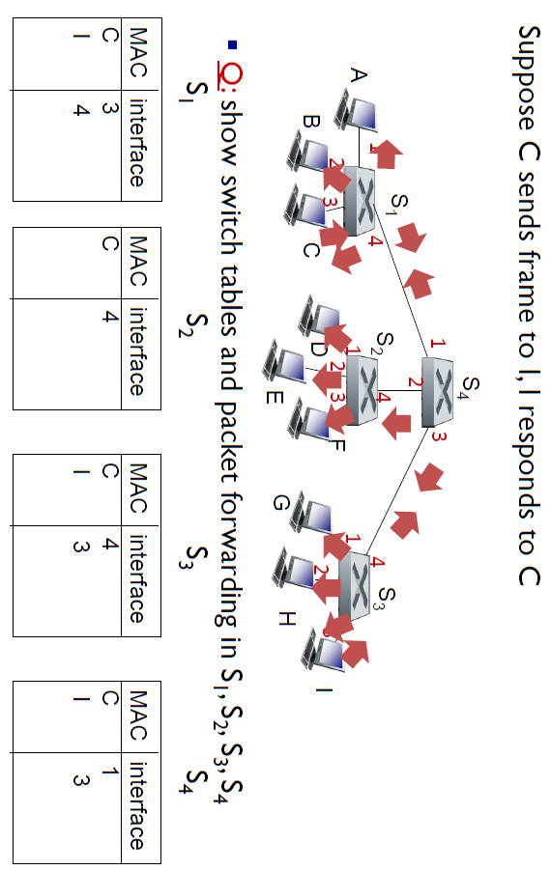
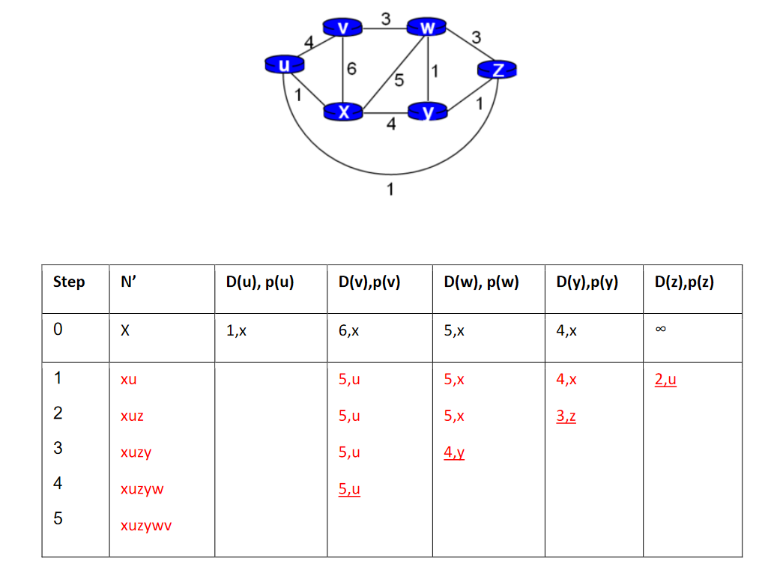
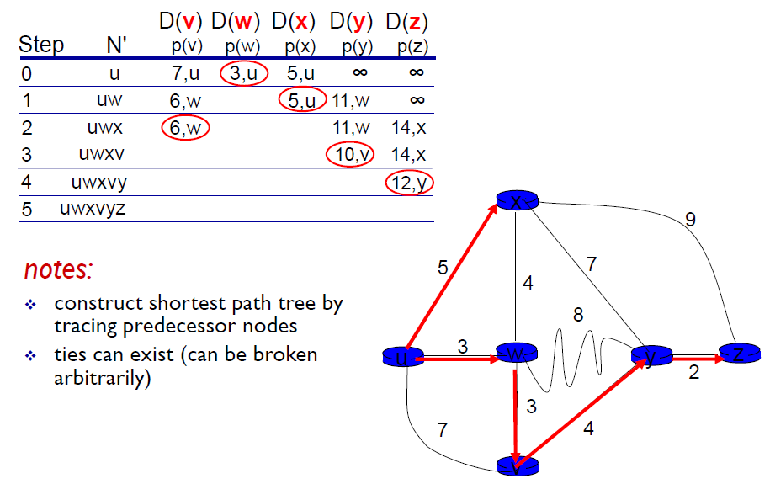
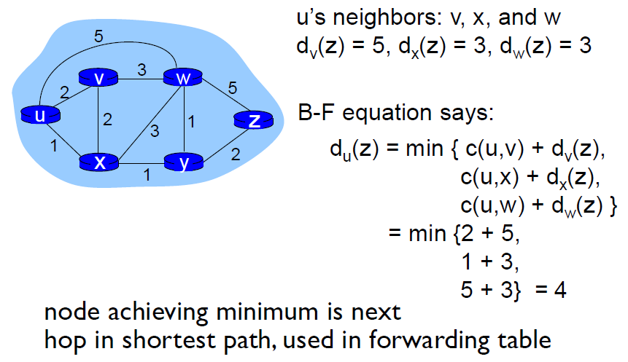
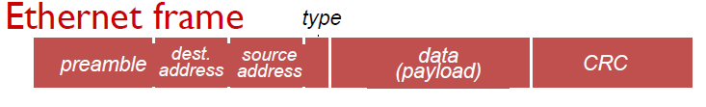
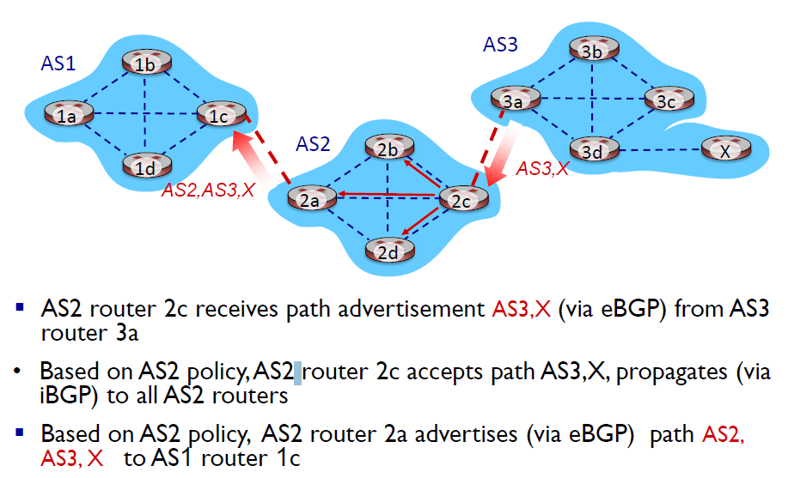
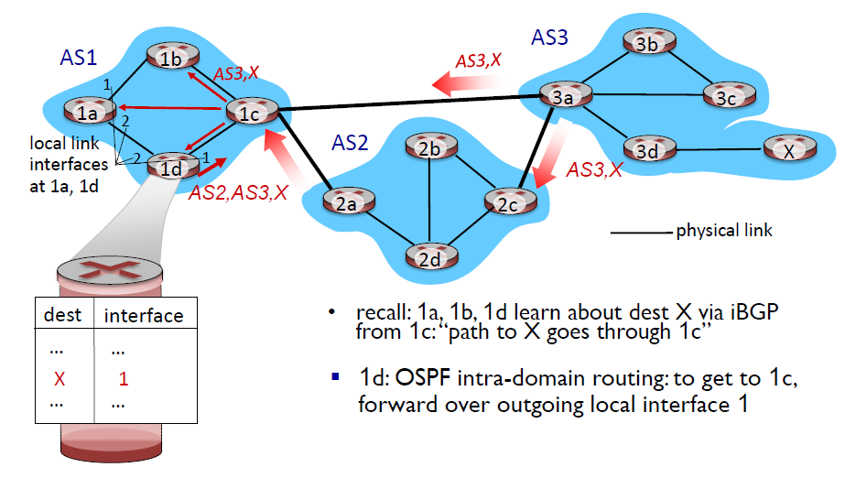
Dijkstra’s algorithm
•net topology, link costs known to all nodes
–accomplished via “link state broadcast”
–all nodes have same info
•computes least cost paths from one node (‘source”) to all other nodes
–gives forwarding table for that node
•iterative: after k iterations, know least cost path to k dest.’s
notation:
•c(x,y): link cost from node x to y; = ∞ if not direct neighbors
•D(v): current value of cost of path from source to dest. v
•p(v): predecessor node along path from source to v
•N': set of nodes whose least cost path definitively known
Bellman-Ford equation (dynamic programming) let (distance vector)
dx(y) := cost of least-cost path from x to y
then
dx(y) = min {c(x,v) + dv(y) }
dvy cost from neighbor v to destination y
Cxv cost to neighbor v
minv min taken over all neighbors v of x
link cost changes:
node detects local link cost change
bad news travels slow - “count to infinity” problem!
44 iterations before algorithm stabilizes
poisoned reverse:
If Z routes through Y to get to X :
▪Z tells Y its (Z’s) distance to X is infinite (so Y won’t route to X via Z)
Internet inter-AS routing: BGP
•BGP (Border Gateway Protocol):
–A path-vector protocol
–Route info:
•CIDRized Prefix (e.g., 1.1.8.0/24) + AS-path + Next-hop (IP address of gateway router to enter the path) –Why AS-path? Import-policy, avoid loop
•BGP provides each AS a means to:
–eBGP: obtain subnet reachability information from neighboring ASes
–iBGP: propagate reachability information to all AS-internal routers.
–determine “good” routes to other networks based on reachability information and policy
walkthrough: send datagram from A to B via R
▪focus on addressing – at IP (datagram) and MAC layer (frame)
▪assume A knows B’s IP address
▪assume A knows IP address of first hop router, R (how?)
▪assume A knows R’s MAC address (how?)
▪A creates IP datagram with IP source A, destination B
▪A creates link-layer frame with R's MAC address as destination address, frame contains A-to-B IP datagram
▪frame sent from A to R
▪frame received at R, datagram removed, passed up t▪R forwards datagram with IP source A, destination B
▪R creates link-layer frame with B's MAC address as destination address, frame contains A-to-B IP datagram
▪R forwards datagram with IP source A, destination B
▪R creates link-layer frame with B's MAC address as dest, frame contains A-to-B IP datagram
Switches vs. routers
both are store-and-forward:
▪routers: network-layer devices (examine network-layer headers)
▪switches: link-layer devices (examine link-layer headers)
both have forwarding tables:
▪routers: compute tables using routing algorithms, IP addresses
▪switches: learn forwarding table using flooding, learning, MAC addresses
Switch link + physical (frame)
Router network link physical (datagram, frame)
policy:
•inter-AS: admin wants control over how its traffic routed, who routes through its net.
•intra-AS: single admin, so no policy decisions needed
scale:
•Scalability is critical for inter-AS routing
•intra-AS: less an issue, can always use hierarchical routing to reduce scale
performance:
•intra-AS: can focus on performance
•inter-AS: policy may dominate over performance
802.11
▪wireless host communicates with base station
•base station = access point (AP)
▪Basic Service Set (BSS) (aka “cell”) in infrastructure mode contains:
•wireless hosts
•access point (AP): base station
passive scanning:
(1)Beacon frames sent from APs
(2)Association Request frame sent: H1 to selected AP
(3)Association Response frame sent from selected AP to H1
active scanning:
(1)Probe Request frame broadcast from H1
(2)Probe Response frames sent from APs
(3)Association Request frame sent: H1 to selected AP
(4)Association Response frame sent from selected AP to H1
-S1, experiencing link failure using OpenFlow port status message to notify controller
-SDN controller receives OpenFlow message, updates link status info
-Dijkstra’s routing algorithm application has previously registered to be called when ever link status changes. It is called.
-Dijkstra’s routing algorithm access network graph info, link state info in controller, computes new routes
-link state routing app interacts with flow-table-computation component in SDN controller, which computes new flow tables needed
-Controller uses OpenFlow to install new tables in switches that need updating
message complexity
•LS: with n nodes, E links, O(nE) msgs sent
•DV: exchange between neighbors only
–convergence time varies
speed of convergence
•LS: O(n2) algorithm requires O(nE) msgs
–may have oscillations
•DV: convergence time varies
–may have routing loops
–count-to-infinity problem
robustness: what happens if router malfunctions?
LS:
–node can advertise incorrect link cost
–each node computes only its own table
DV:
–DV node can advertise incorrect path cost
–each node’s table used by others
•error propagate thru network
CSMA/CD for wired link
•collisions detected within short time
–colliding transmissions aborted, reducing channel wastage
•collision detection:
–easy in wired LANs: measure signal strengths, compare transmitted, received signals
–difficult in wireless LANs: received signal strength overwhelmed by local transmission strength
IEEE 802.11: multiple access
•802.11: no collision detection!
–difficult to receive (sense collisions) when transmitting due to weak received signals (fading)
–can’t sense all collisions in any case: hidden terminal, fading
–goal: avoid collisions: CSMA/C(ollision)A(voidance)
802.11 sender
1 if sense channel idle for DIFS (DCF Inter-frame space) then
transmit entire frame (no Collision Detection)
2 if sense channel busy then
start random backoff time
timer counts down while channel idle
transmit when timer expires
if no ACK, increase random backoff interval (exponential increase here), repeat 2
802.11 receiver
- if frame received OK
return ACK after SIFS (Short inter-frame space)
idea: allow sender to “reserve” channel rather than random access of data frames: avoid collisions of long data frames
•sender first transmits small request-to-send (RTS) packets to BS using CSMA
–RTSs may still collide with each other (but they’re short)
•BS broadcasts clear-to-send CTS in response to RTS
•CTS heard by all nodes
–sender transmits data frame
–other stations defer transmissions
avoid data frame collisions completely
using small reservation packets!
sending adapter encapsulates IP datagram (or other network layer protocol packet) in Ethernet frame
preamble:
•7 bytes with pattern 10101010 followed by one byte with pattern 10101011
• used to synchronize receiver, sender clock rates
•more powerful error-detection coding
•view data bits, D, as a binary number
•choose r+1 bit pattern (generator), G
•goal: choose r CRC bits, R, such that
– <D,R> exactly divisible by G (modulo 2)
–receiver knows G, divides <D,R> by G. If non-zero remainder: error detected!
–can detect all burst errors less than r+1 bits
•widely used in practice (Ethernet, 802.11 WiFi, ATM)
switch learns which hosts can be reached through which interfaces
–when frame received, switch “learns” location of sender: incoming LAN segment
–records sender/location pair in switch table
intra-AS routing
▪routing among hosts, routers in same AS (“network”)
▪all routers in AS must run same intra-domain protocol
▪routers in different AS can run different intra-domain routing protocol
▪gateway router: at “edge” of its own AS, has link(s) to router(s) in other AS’es
terminology:
•hosts and routers: nodes
•communication channels that connect adjacent nodes along communication path: links
–wired links
–wireless links
•layer-2 packet: frame, encapsulates datagram
data-link layer has responsibility of transferring datagram from one node to physically adjacent node over a link
ARP table: each IP node (host, router) on LAN has table
–IP/MAC address mappings for some LAN nodes:
< IP address; MAC address; TTL>
–TTL (Time To Live): time after which address mapping will be forgotten (typically 20 min)
inter-AS routing
•routing among AS’es
•gateways perform inter-domain routing (as well as intra-domain routing)
forwarding table configured by both intra- and inter-AS routing algorithm
–intra-AS routing determine entries for destinations within AS
–inter-AS & intra-AS determine entries for external destinations
OSPF (Open Shortest Path First)
•“open”: publicly available
•uses link-state algorithm
–link state packet dissemination
–topology map at each node
–route computation using Dijkstra’s algorithm
•router floods OSPF link-state advertisements to all other routers in entire AS
–carried in OSPF messages directly over IP (rather than TCP or UDP
–link state: for each attached link
•IS-IS routing protocol: nearly identical to OSPF
A wants to send datagram to B
–B’s MAC address not in A’s ARP table.
•A broadcasts ARP query packet, containing B's IP address
–destination MAC address = FF-FF-FF-FF-FF-FF
–all nodes on LAN receive ARP query
•B receives ARP packet, replies to A with its (B's) MAC address
–frame sent to A’s MAC address (unicast)
•A caches (saves) IP-to-MAC address pair in its ARP table until information becomes old (times out)
–soft state: information that times out (goes away) unless refreshed
•ARP is “plug-and-play”:
–nodes create their ARP tables without intervention from net administrator
BGP sequentially invokes the following rules to select a route:
1.local preference value attribute: policy decision
2.shortest AS-PATH
3.closest NEXT-HOP router: hot potato routing
4.additional criteria

